Slide 1

Build Your Dream Bedroom
DelightEx Introduction
Duration: 45-60 minutes
Notes:
Simplified Version -> Display Only https://gamma.app/docs/Build-Your-Dream-Bedroom-9ar0llxqtzf3ccu

Slide 2
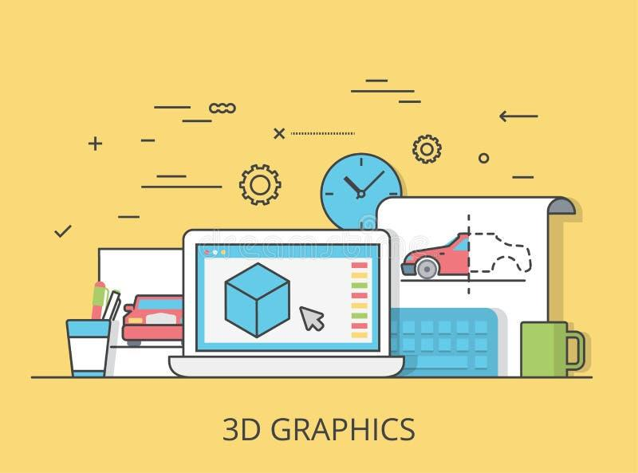




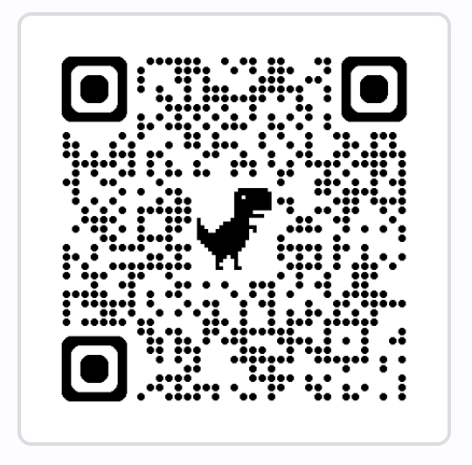
Lesson Objective
3D Workspace Navigation
Library Browsing
Drag & Drop Objects
Material Editing

Slide 3


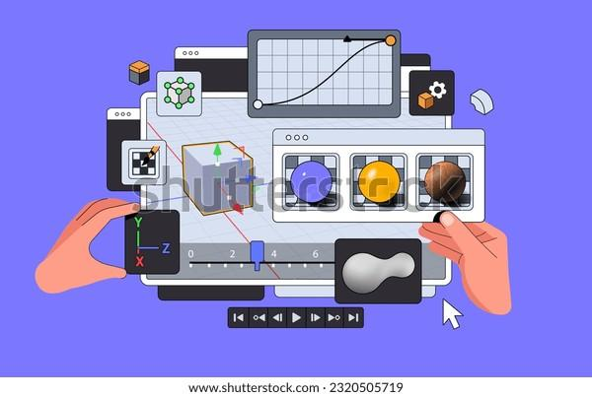





Key Skills Covered
Navigation
Library Browsing
Moving around the 3D workspace
Finding objects in categories
Drag and Drop
Selection
Adding objects to the scene
Clicking to select objects
Transform Tools
Renaming
Moving, rotating, scaling objects
Giving objects meaningful names
Duplicating
Grouping
Creating copies of objects
Organizing multiple objects
Material Editing
Play Mode
Changing colors/textures
Exploring creation in first-person

Slide 4

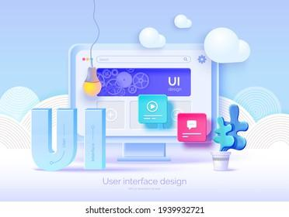


Part 1: Getting Started 1
Open Delightex Local Editor - Make a new scene
Students open Delightex and create a new Project
Choose Environment
Can choose either empty project or ‘large gallery’
Guided Tour
Brief tour of Library, tools, and Play button locations

Slide 5
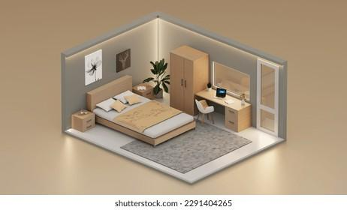







Part 2: Guided Building 25 min
Challenge: Build a Bedroom
1 bed
1 desk or table
1 chair
1 window or door
2 decorative items
Required Skills Practice
1
Find bed in Library
2
Drag & drop into scene
3
Select by clicking
4
Scale to appropriate size
5
Rename to "My Bed"
6
Duplicate the chair
7
Group furniture together
8
Change colors of objects

Slide 6
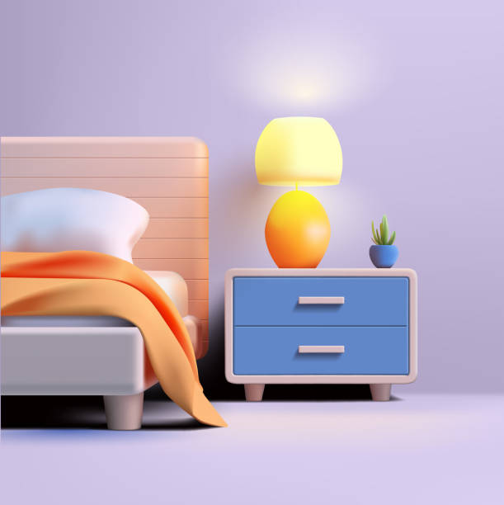






Part 3: Free Creation 10 min
Add Personal Touches
Posters
Plants
Toys
Pets
Experiment with Animations
Which Elements/items can be animated?

Slide 7




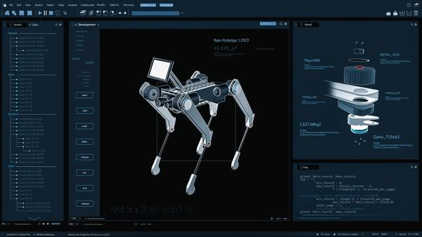





Extension Ideas
For Fast Finishers
Add a second room (bathroom or closet)
Use building blocks for custom furniture
Add a pet with animation
Introduction to CoBlocks
Make a door that opens when clicked
Add interactive elements to bedroom
Notes:
Show students how to create a path and make an animal e.g unicorn move forever w/animations

Slide 8


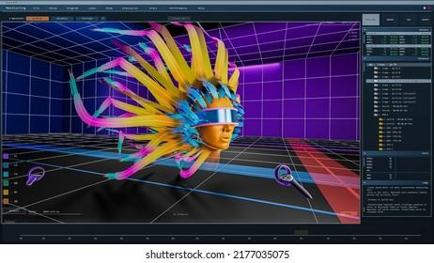
Assessment/Success Criteria
Students successfully demonstrated the skill if they can:
Navigate the 3D workspace
Find and add 5+ objects
Resize objects appropriately
Create at least one duplicate
Group multiple objects
Change colors of objects
Explore scene in Play mode

